Slide 1
Conditional Random Fields and beyond …
Daniel Khashabi
CS 546
UIUC, 2013

Slide 2
Outline
Modeling
Inference
Training
Applications

Slide 3
Outline
Modeling
Problem definition
Discriminative vs. Generative
Chain CRF
General CRF
Inference
Training
Applications

Slide 4
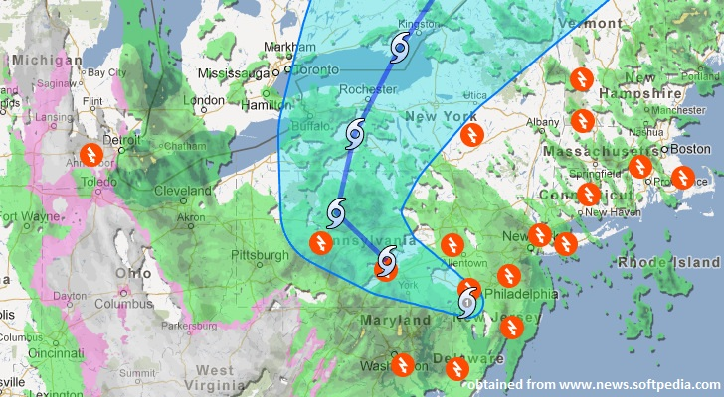
Problem Description
Given (observations), find (predictions)
For example,
Might depend on previous days and each other
Might depend on previous days and each other

Slide 5
Problem Description
The relational connection occurs in many applications, NLP, Computer Vision, Signal Processing, ….
Traditionally in graphical models,
Modeling the joint distribution can lead to difficulties
rich local features occur in relational data,
features may have complex dependencies,
constructing probability distribution over them is difficult
Solution: directly model the conditional,
is sufficient for classification!
CRF is simply a conditional distribution with an associated graphical structure
Intractable!

Slide 6
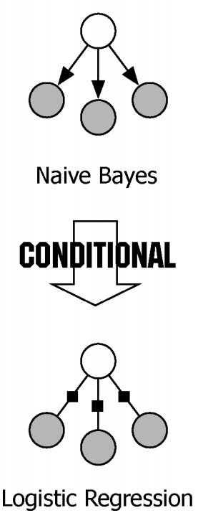
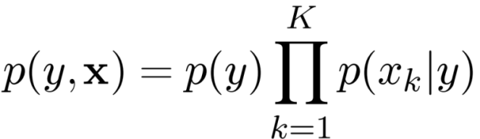
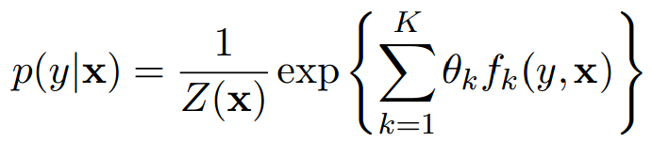
Discriminative Vs. Generative
Generative Model: A model that generate observed data randomly
Naïve Bayes: once the class label is known, all the features are independent
Discriminative: Directly estimate the posterior probability; Aim at modeling the “discrimination” between different outputs
MaxEnt classifier: linear combination of feature function in the exponent,
Both generative models and discriminative models describe distributions over (y , x), but they work in different directions.

Slide 7
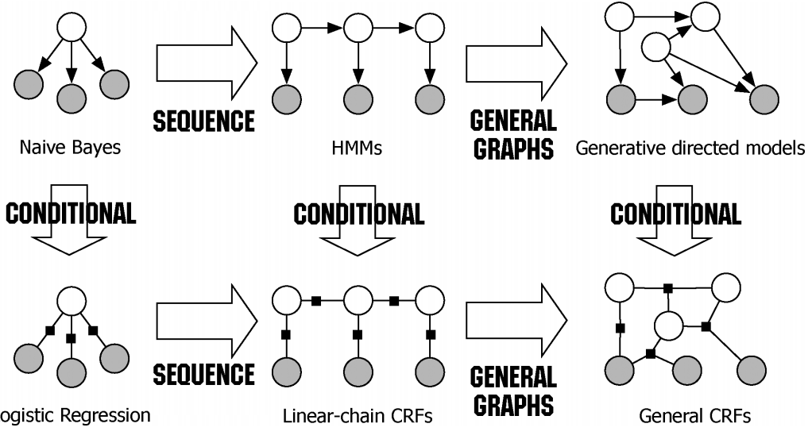
Discriminative Vs. Generative
=observable
=unobservable

Slide 8
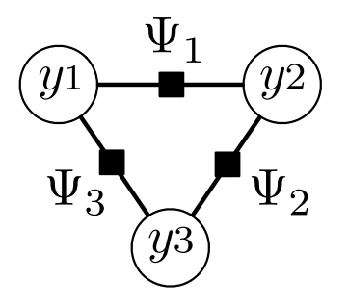
Markov Random Field(MRF) and Factor Graphs
On an undirected graph, the joint distribution of variables
:Potential function
Typically :
:Partition function
Not all distributions satisfy Markovian properties
Hammersley-Clifford Theorem
The ones which do can be factorized
factor
variable

Slide 9
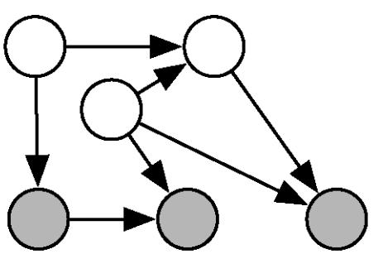
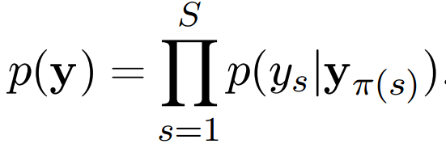
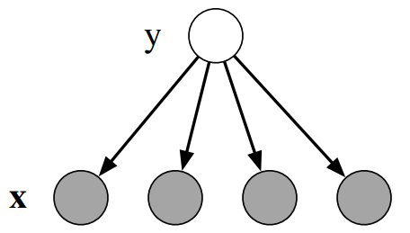

Directed Graphical Models(Bayesian Network)
Local conditional distributions
If indices of the parents of
Generally used as generative models
E.g. Naïve Bayes: once the class label is known, all the features are independent

Slide 10

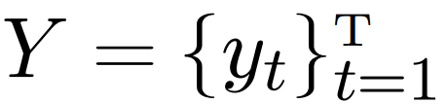
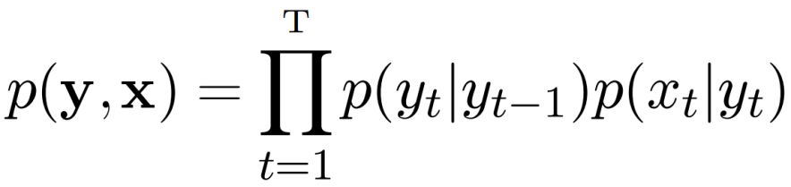
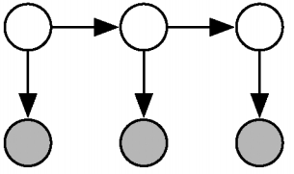
Sequence prediction
Like NER: identifying and classifying proper names in text, e.g. China as location; George Bush as people; United Nations as organizations
_{Set of observation,}
Set of underlying sequence of states,
_{HMM is generative:}
Doesn’t model long-range dependencies
Not practical to represent multiple interacting features (hard to model p(x))
The primary advantage of CRFs over hidden Markov models is their conditional nature, resulting in the relaxation of the independence assumptions
And it can handle overlapping features
Transition probability
Observation probability

Slide 11
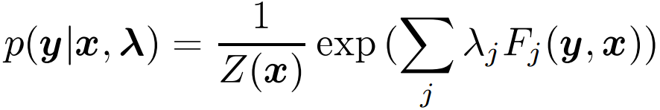
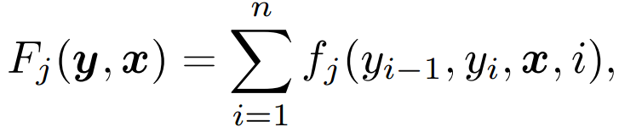

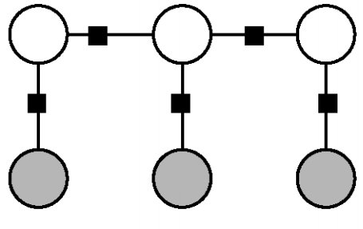
Chain CRFs
Each potential function will operate on pairs of adjacent label variables
Parameters to be estimated,
Feature functions
=unobservable
=observable

Slide 12
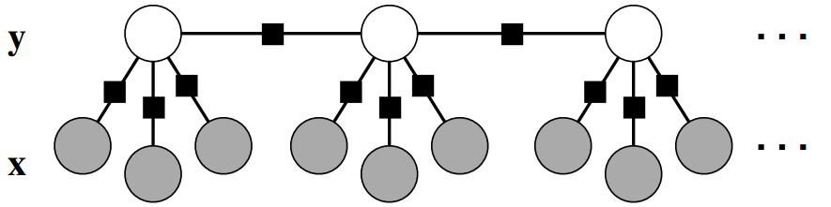
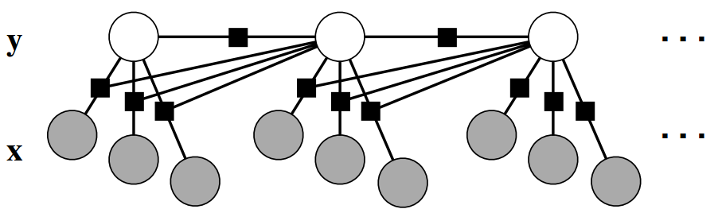
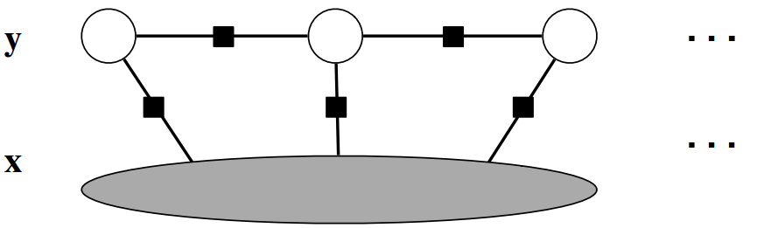
Chain CRF
We can change it so that each state depends on more observations
Or inputs at previous steps
Or all inputs
=unobservable
=observable

Slide 13






General CRF: visualization
If , and , ;
and are neighbors
is a CRF, if
Y
the MRF
the CRF
X
fixed, observable, variables X (not in the MRF)
Note that in a CRF we do not explicitly model any direct relationships between the observables (i.e., among the X) (Lafferty et al., 2001).
Hammersley-Clifford does not apply to X!

Slide 14
General CRF: visualization
Divide y MRF into cliques. The parameters inside each template are tied --potential functions; functions for the template
Y
cliques (include only the unobservables, Y)
CRF
X
observables, X (not included in the cliques)
Note that we are not summing
over x in the denominator
The cliques contain only unobservables (y); though, x is an argument to Φ_{c}
The probability P_{M}(y|x) is a joint distribution over the unobservables Y

Slide 15
General CRF: visualization
A number of ad hoc modeling decisions are typically made with regard to the form of the potential functions.
Φ_{c} is typically decomposed into a weighted sum of feature sensors f_{i}, producing:
Back to the chain-CRF!
Cliques can be identified as pairs of adjacent Ys:

Slide 16
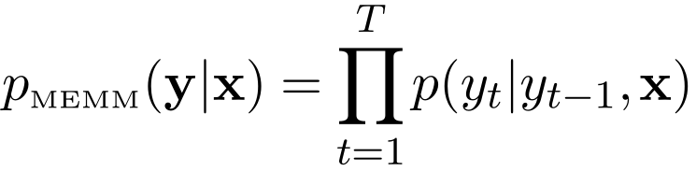
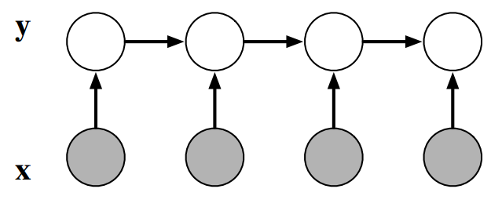
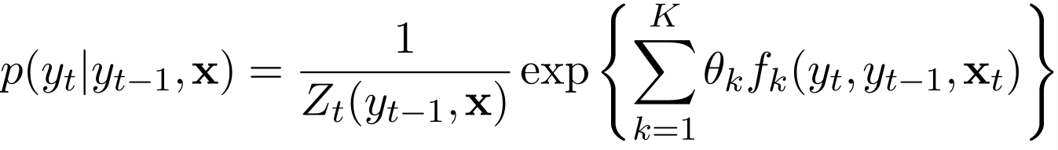
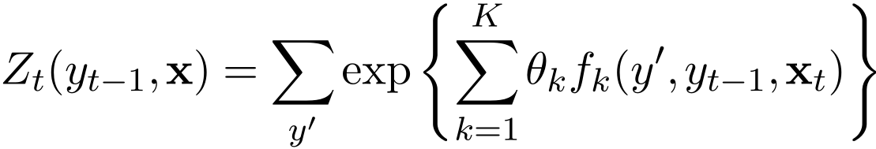
Chain CRFs vs. MEMM
Linear-chain CRFs were originally introduced as an improvement to MEMM
Maximum Entropy Markov Models (MEMM)
Transition probabilities are given by logistic regression
Notice the per-state normalization
Only dependent on the previous inputs; no dependence on the future states.
Label-bias problem

Slide 17
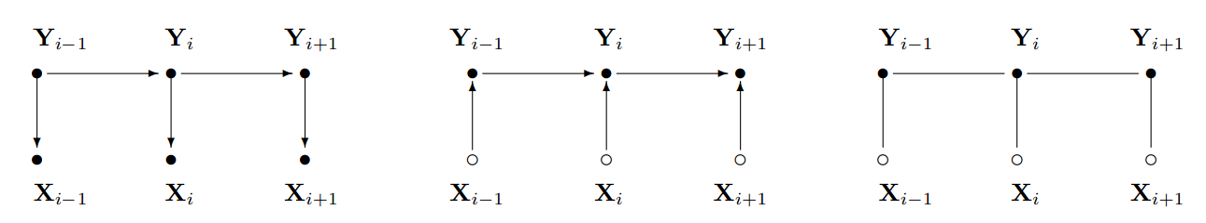
CRFs vs. MEMM vs. HMM
HMM
MEMM
CRF

Slide 18
Outline
Modeling
Inference
General CRF
Chain CRF
Training
Applications

Slide 19

Inference
Given the observations,{xi})and parameters, we target to find the best state sequence
For the general CRF:
For general graphs, the problem of exact inference in CRFs is intractable
Approximate methods ! A large literature …

Slide 20
Inference in HMM
Dynamic Programming:
Forward
Backward
Viterbi
1
1
1
1
…
1
2
2
2
2
2
…
2
…
…
…
…
K
K
K
K
…
K

Slide 21


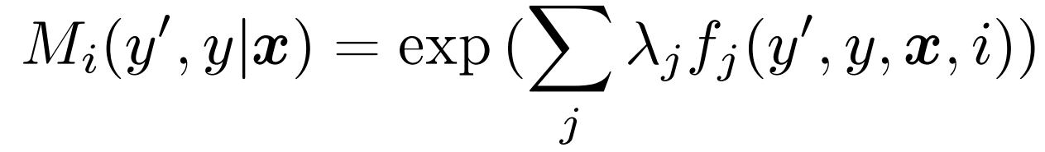
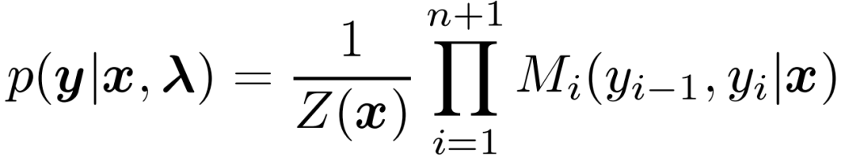
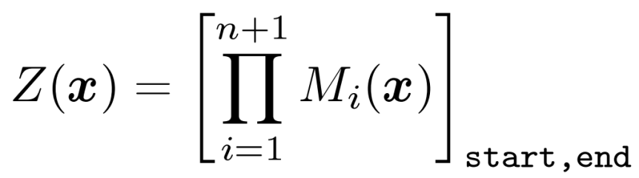
Parameter Learning: Chain CRF
Chain CRF could be done using dynamic programming
Assume
Naively doing could be intractable:
Define a matrix with size

Slide 22


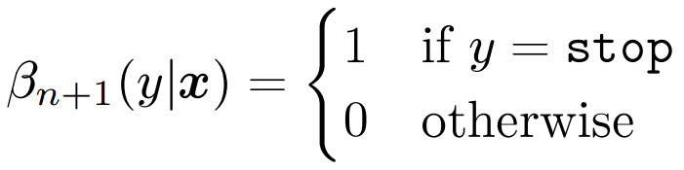
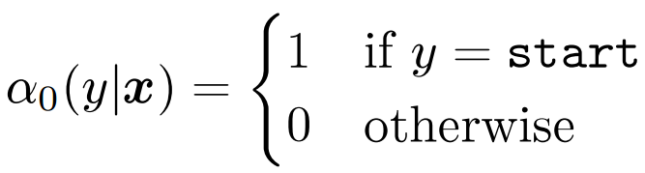


Parameter Learning: Chain CRF
By defining the following forward and backward parameters,

Slide 23
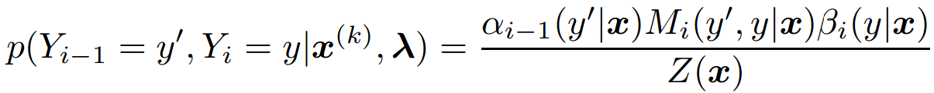
Inference: Chain-CRF
The inference of linear-chain CRF is very similar to that of HMM
We can write the marginal distribution:
Solve Chain-CRF using Dynamic Programming (Similar to Viterbi)!
1. First computing α for all t (forward), then compute β for all t (backward).
2. Return the marginal distributions computed.
3. Run viterbi to find the optimal sequence

Slide 24
Outline
Modeling
Inference
Training
General CRF
Some notes on approximate learning
Applications

Slide 25

Parameter Learning
Given the training data, we wish to learn parameters of the model.
For chain or tree structured CRFs, they can be trained by maximum likelihood
The objective function for chain-CRF is convex(see Lafferty et al(2001) ).
General CRFs are intractable hence approximation solutions are necessary

Slide 26
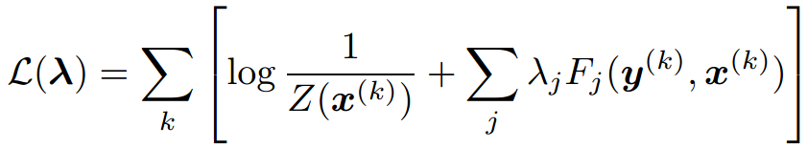
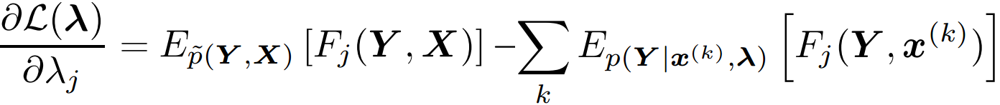
Parameter Learning
Given the training data, we wish to learn parameters of the mode.
Conditional log-likelihood for a general CRF:
It is not possible to analytically determine the parameter values that maximize the log-likelihood – setting the gradient to zero and solving for λ does not always yield a closed form solution. (Almost always)
Empirical Distribution
Hard to calculate!

Slide 27
Parameter Learning
This could be done using gradient descent
Until we reach convergence
Or any other optimization:
Quasi-Newton methods: BFGS [Bertsekas,1999] or L-BFGS [Byrd, 1994]
General CRFs are intractable hence approximation solutions are necessary
Regularization:
σ is a regularization parameter
Compared with Markov chains, CRF’s should be more discriminative, much slower to train and possibly more susceptible to over-training.

Slide 28

Training ( and Inference): General Case
Approximate solution, to get faster inference.
Treat inference as shortest path problem in the network consisting of paths(with costs)
Max Flow-Min Cut (Ford-Fulkerson, 1956 )
Pseudo-likelihood approximation:
Convert a CRF into separate patches; each consists of a hidden node and true values of neighbors; Run ML on separate patches
Efficient but may over-estimate inter-dependencies
Belief propagation?!
variational inference algorithm
it is a direct generalization of the exact inference algorithms for linear-chain CRFs
Sampling based method(MCMC)
sorry about
that, man!

Slide 29

CRF frontiers
Bayesian CRF:
Because of the large number of parameters in typical applications of CRFs
prone to overfitting.
Regularization?
Instead of
Too complicated! How can we approximate this?
Semi-supervised CRF:
The need to have big labeled data!
Unlike in generative models, it is less obvious how to incorporate unlabelled data into a conditional criterion, because the unlabelled data is a sample from the distribution

Slide 30
Outline
Modeling
Inference
Training
Some Applications

Slide 31
Some applications: Part-of-Speech-Tagging
POS(part of speech) tagging; the identification of words as nouns, verbs, adjectives, adverbs, etc.
CRF features:
Students
need
another
break
noun
verb
article
noun
Feature Type | Description
Transition | ∀k,k’ y_{i} = k and y_{i+1}=k’
Word | ∀k,w y_{i} = k and x_{i}=w ∀k,w y_{i} = k and x_{i-1}=w ∀k,w y_{i} = k and x_{i+1}=w ∀k,w,w’ y_{i} = k and x_{i}=w and x_{i-1}=w’ ∀k,w,w’ y_{i} = k and x_{i}=w and x_{i+1}=w’
Orthography: Suffix | ∀s in {“ing”,”ed”,”ogy”,”s”,”ly”,”ion”,”tion”, “ity”, …} and ∀k y_{i}=k and x_{i} ends with s
Orthography: Punctuation | ∀k y_{i} = k and x_{i} is capitalized ∀k y_{i} = k and x_{i} is hyphenated …

Slide 32
Is HMM(Gen.) better or CRF(Disc.)
If your application gives you good structural information such that could be easily modeled by dependent distributions, and could be learnt tractably, go the generative way!
Ex. Higher-order emissions from individual states
Incorporating evolutionary conservation from an alignment: PhyloHMM, for which efficient decoding methods exist:
“unobservables”
“observables”
A A T C G
states
target genome
“informant” genomes

Slide 33
References
J. Lafferty, A. McCallum, and F. Pereira. Conditional random ﬁelds: Probabilistic models for segmenting and labeling sequence data. In Proc. ICML01, 2001.
Charles Elkan, “Log-linear Models and Conditional Random Field,” Notes for a tutorial at CIKM, 2008.
Charles Sutton and Andrew McCallum, “An Introduction to Conditional Random Fields for Relational Learning,” MIT Press, 2006
Slides: An Introduction to Conditional Random Field, Ching-Chun Hsiao
Hanna M. Wallach , Conditional Random Fields: An Introduction, 2004
Sutton, Charles, and Andrew McCallum. An introduction to conditional random fields for relational learning. Introduction to statistical relational learning. MIT Press, 2006.
Sutton, Charles, and Andrew McCallum. "An introduction to conditional random fields." arXiv preprint arXiv:1011.4088 (2010).
B. Majoros, Conditional Random Fields, for eukaryotic gene prediction

